Slide 1
#BuildTheFuture
#BeSuffolksFuture
Notes:
Good afternoon everyone!
My name is **** and it is a pleasure to be here this morning/afternoon/evening.
I am here today from Apprenticeships Suffolk which is a project being run by Suffolk County Council. I we are going to be telling you a little bit about apprenticeships and our service.
So, just to get started, I would love you to write down, what you think an Apprenticeship is and maybe what we do? I won’t ask you to share all of this info, but I would like to see at the end if you have a better idea of why I am here today. (and if you do, tell my Manager!!)
SECOND OPTION – ACTIVITY
Start with the true and false ideas – get everyone up and move to left and right.
There are over 600 apprenticeship roles?
You get paid to study?
You can be a paramedic on an apprenticeship?
You get the same qualification you would at university?
You can do several apprenticeships in different roles?

Slide 2
Supports businesses in Suffolk to create apprenticeship opportunities.
Provide information, advice and guidance to education settings.
Liaise with Training provider to support with course delivery
OUR SERVICE
Signpost to services and opportunities that best suit your needs.
Support individuals 16+ who are ready to explore their next steps.
Support both employer and apprentice throughout the apprenticeship journey.
Notes:
Apprenticeships Suffolk is a completely free service, we are not a College or Training Provider and we provide impartial support, advice and guidance.
We speak with Small to Medium Sized Businesses in Suffolk to create apprenticeship opportunities. We then also work with aspiring apprentices who are ready to take their next steps and explore the apprenticeship route.
We also signpost to other services if you are not quite ready for an apprenticeship or feel the apprenticeship route is not quite for you.
We support you and the employer throughout the whole apprenticeship journey. From recruitment, apprenticeship offered, finding a TP/FE College then throughout your apprenticeship itself.

Slide 3
What really is an apprenticeship?
Employed to do a real job whilst studying for a real qualification.
(6 hours min paid study)
Earn while you are learn! Many companies offer great perks too!!
Transferable Skills to take with you across your working life.
Gaining and demonstrating knowledge, skills and behaviours and being fully trained in that job role.
Progression onto another apprenticeship or a pathway into a future career. Many Managers and Owners were Apprentices.
Apprenticeships are for those 16+ and available for anyone at any level.
Apprenticeships take 1 to 5 years to complete depending on the level.
Notes:
-You are being paid a full salary, National Minimum Wage for an apprentice is currently £5.28. To put that into perspective a 37 hour week is £850 per month. This is the minimum employers can pay and some companies pay more from the start and wages are reviewed yearly.
-A full time job for an apprentice is between 30-40 hours per week.
-You have 6 hours a week protected study time, this can be either delivered within a College or Education setting one day a week or your Training Provider might deliver in-house , virtually or face to face, meaning you remain in the workplace to complete your study time.
-Some apprenticeships are block release. This means you are based in the workplace and your study time is a residential usually for a week everything 3 months typically with other apprentices.

Slide 4
Maths and English
Not achieved a pass (Grade 4 or C) in Maths and English GCSE
You may need to complete a Functional skills as part of your apprenticeship.
Your Training Provider or College will identify what level you are working at through an initial assessment.
For Level 2 apprenticeships, you will be required to have at least a Level 1 Functional Skills Maths and English.
Level 1 Functional Skills is equivalent to GCSE grades 1 to 3
(D to G in old GCSE grading system)
For a Level 3 to 7 apprenticeship, you will be working towards a Level 2 Functional Skills alongside your apprenticeship.
Level 2 Functional Skills is equivalent to GCSE grades 4-9
(C to A in old GCSE grading system)
Notes:
Functional skills are qualifications taught to post-16 and adult learners, which teach them how to apply practical Maths and English skills to real-life and vocational contexts.
Achieving a Functional Skills qualification demonstrates that you have all the skills required in maths and English to be able to engage with the programme.
You will be required to complete an initial assessment in maths and English with your Training Provider or College to identify what level you are working at.
English and maths are essential to supporting longer-term career prospects. This is why all apprentices must be supported to gain these essential skills and secure recognised qualifications.
If apprentices do not hold a grade C/4 or above in GCSE Maths and English, the apprentice ideally needs to achieve a Level 2 in Maths and English Functional Skills. To support achieving this, all apprentices completing an intermediate apprenticeship will be required to have their Level 1 FS, as a minimum, and where appropriate work towards L2 English & Maths alongside the apprenticeship. Not all apprentices on an intermediate apprenticeship will be required to take the assessment at level 2. However, level 2 English and maths must be achieved if specified within the apprenticeship standard.
For those undertaking an advanced or higher apprenticeship, it is a requirement that they hold or achieve an approved level 2 in both subjects before they can successfully complete the apprenticeship.
For an apprentice with a EHCP these rules may differ and discussed with the individual.

Slide 5
Outdoor Activity Instructor
Operational Firefighter
Plumbing & Heating Engineer
Teaching Assistant
Level 3
Level 3
Florist
Level 3
Level 3
Level 2
Criminal Investigator
Business Administrator
Which of these are Apprenticeship qualifications?
Level 3
Level 6
Customer Service Practitioner
Fashion Studio Assistant
Midwife
Animal Trainer
Level 3
Level 2
Level 6
Level 4
Game Software Developer
Autocare Technician
Paramedic
Horticulture & Landscape operative
Level 6
Level 2
Level 7
Level 2
Notes:
To give you an idea of the different types of apprenticeships on offer, we have provided a few examples here for you to have a look at. You may be surprised to learn that you can do an apprenticeship in midwifery for example, which is a level 6 apprenticeship also known as a degree apprenticeship. There are 638 apprenticeships standards approved for delivery so there is a very broad range of options to choose from. You just need to find a suitable employer who can offer this and a suitable provider to deliver the training programme (local or nationally).
As you can see there are different levels attached to the apprenticeship standards, and if we go onto the next slide you will see why.

Slide 6
So where do I start?
Notes:
Read slide.

Slide 7
TO DO LIST:
Consider your interests - What is it you want to do? There are several helpful sites to help you discover career options based on your interests, skills and attributes “I can be a… ” and “Careers Quiz” on the UCAS website.
Do your research – How can I get into my preferred industry? What qualifications/ experience will I need?
Attend career events (virtual or in person). Set up a LinkedIn profile.
Find local employers and approach to request some work experience.
Build your CV and cover letter for job applications.
Register on National Apprenticeship Service gov.uk for current apprenticeship opportunities.
Register with Apprenticeships Suffolk where you will receive ongoing support from our Participant Advisor. You will receive our Wednesday Weekly which shares our current live job vacancies, and you will be invited to apply to new opportunities within our service.
Notes:
So – how do you get started? To Do list to help you with your next steps. First of all its important to start building the foundations by establishing what it is you want to do – researching your interests and discovering possible career goals. We have included a couple of links to useful resources such as the I can be a careers quiz as well as the Careers Quiz on UCAS If you are a bit unsure about what you would like to do. These are fun little quizzes you can do which give you job suggestions based on your answers.
You have also made the first step by attending todays career event to learn more about apprenticeships which is a great starting point.
Now you need to start thinking about putting a CV together and thinking about what is going to make you stand out from the crowd – do you do any extra curriculars, do you do some volunteering, sports clubs, work experience. Start thinking about what you are going to put on CV and if its looking a little bit empty go and speak to you careers team about opportunities you can do to improve CV or there is a great CV builder on the Yojo app and Icanbea website.
If you’re re considering doing an apprenticeship in the future you can register with the national apprenticeship service where you will find a long list of vacancies in your local area. You can also register with Apprenticeships Suffolk for information, advice and guidance on apprenticeships. (You have to be 16+ for our service).

Slide 8
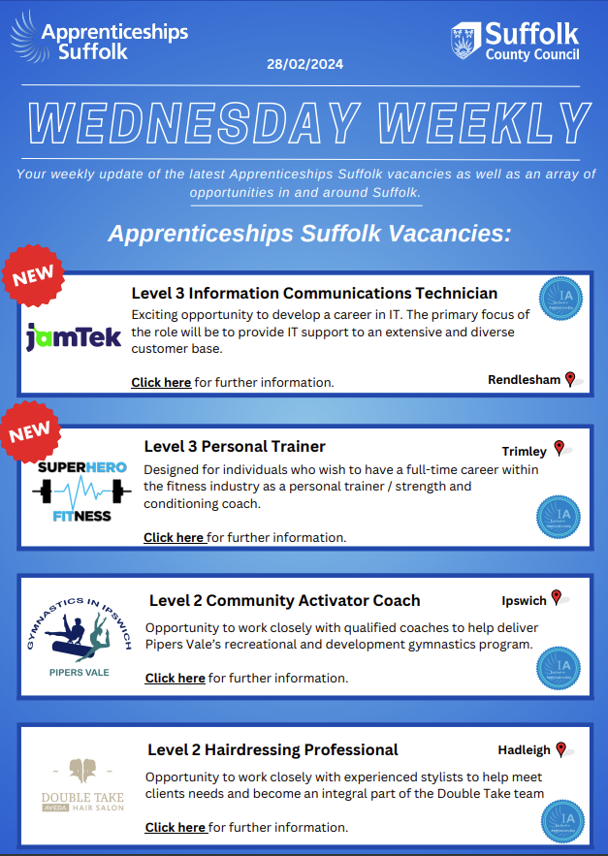
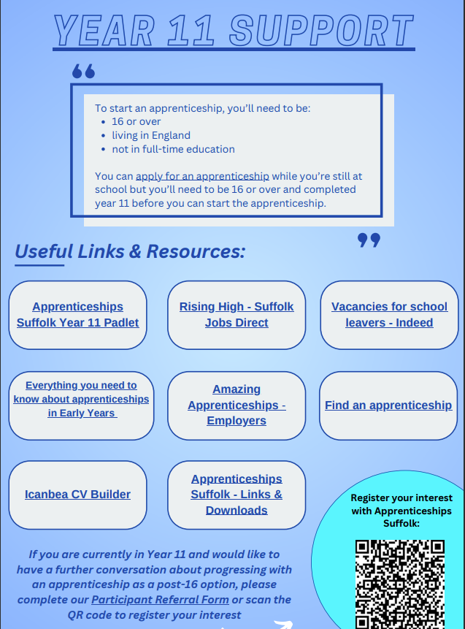
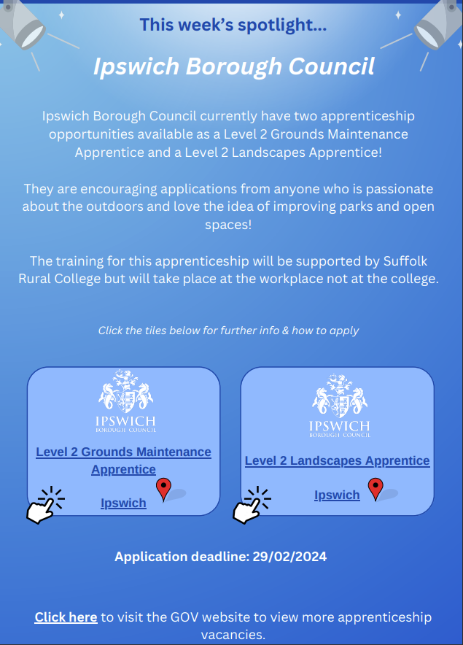
Subscribe to the Wednesday Weekly

Slide 9
How to refer to Apprenticeships Suffolk:
Visit our website at: www.apprenticeshipssuffolk.org
- Contact Us Page.
​
Complete our referral form and send to apprenticeships@suffolk.gov.uk ​
Follow us on Social media for more information.
Notes:
Read slide.

